Slide 1
Smart Cleaning
Submitted To : Dr. Ashima Singh | Submitted By: Jhonsy Bansal (801732025) Gurkirat Singh (801832016) Harmandeep Singh (801832018) Kamal Kant (801832023)

Slide 2
Table of Content
Background of project and existing work
Scope and Utility of the project
Constraints and assumptions
Standards to be used
Architecture of the project
Technology and tools used
Most relevant snapshot of the project
Professional and technical learning
Flow chart
Key highlights of project/outcomes

Slide 3
Background of project and existing work
Major attention in robotics research with IOT due to its effectiveness in assisting humans.
Existing robots are either too expensive or sophisticated that cannot be used in general.
Our robot will be fully autonomous and making decisions on the basis of the outputs of various sensors after being processed by Arduino controller and control the actuators by the H-bridge driving circuitry and it can even operated by the the app over the internet.
Some of the existing work
Roomba - 2002, iRobot (American)
Scooba - 2005, iRobot (American)
Braava - 2006, Neato-Robots XV series (California)/China
Neato XV-11 - 2010, Neato-Robots XV series (California)/China
EYE-360 - 2016, Dyson (UK)
Notes:
In recent years, robotic cleaners have taken major attention in robotics research due to their effectiveness in assisting humans in floor cleaning applications at homes, hotels, restaurants, offices, hospitals, workshops, warehouses and universities etc.

Slide 4
Scope and Utility of the project
Scope
Assemble & Integrate the different parts together.
Calibration of hardware with coding.
Connect the device with Internet and operate it through app.
Utility
Fully Autonomous
IOT Enabled
Notes:
Scope include the tasks we have to perform and their boundries or goals that need to be met to achieve a satisfactory result

Slide 5
Constraints and assumptions
Constraints
Large objects cannot be sucked by the cleaner.
The garbage bucket will be cleaned manually.
Cannot dock itself to charging point due to cost constraints
Assumptions *
The surface should be is plane and not slippery

Slide 6
Standard to be used*
IEEE Std 1621 : Standard for User Interface Elements in Power Control of Electronic Devices Employed in Office/Consumer Environments
IEEE 801.11 : for Wireless connection
IEC 62061 : Functional safety of electrical, electronic and programmable electronic control systems

Slide 7
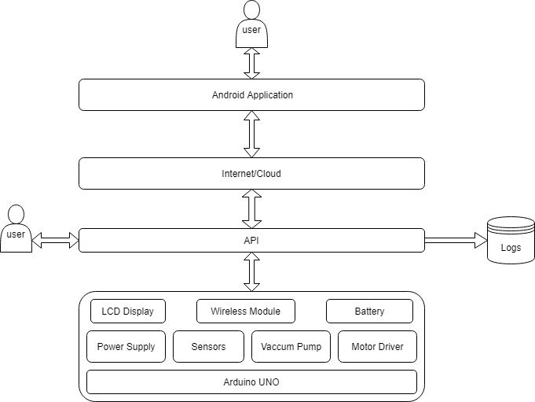
Architecture of the Project

Slide 8
Technique and Tools used
Techniques
Iterative Technique
Tools
Slack - for group discussion
Arduino Board - to control everything
Motor Driver - to control motors
Android Studio - For Android app programming
Arduino IDE - For Arduino UNO programming
Notes:
A tool is a device or computer app that enables you do do something. For example, a microscope or a modeling program. A technique is a process or procedure that you follow. For example there are guidelines for how to construct an effective scientific experiment such as you make sure the participants are unbiased.

Slide 9
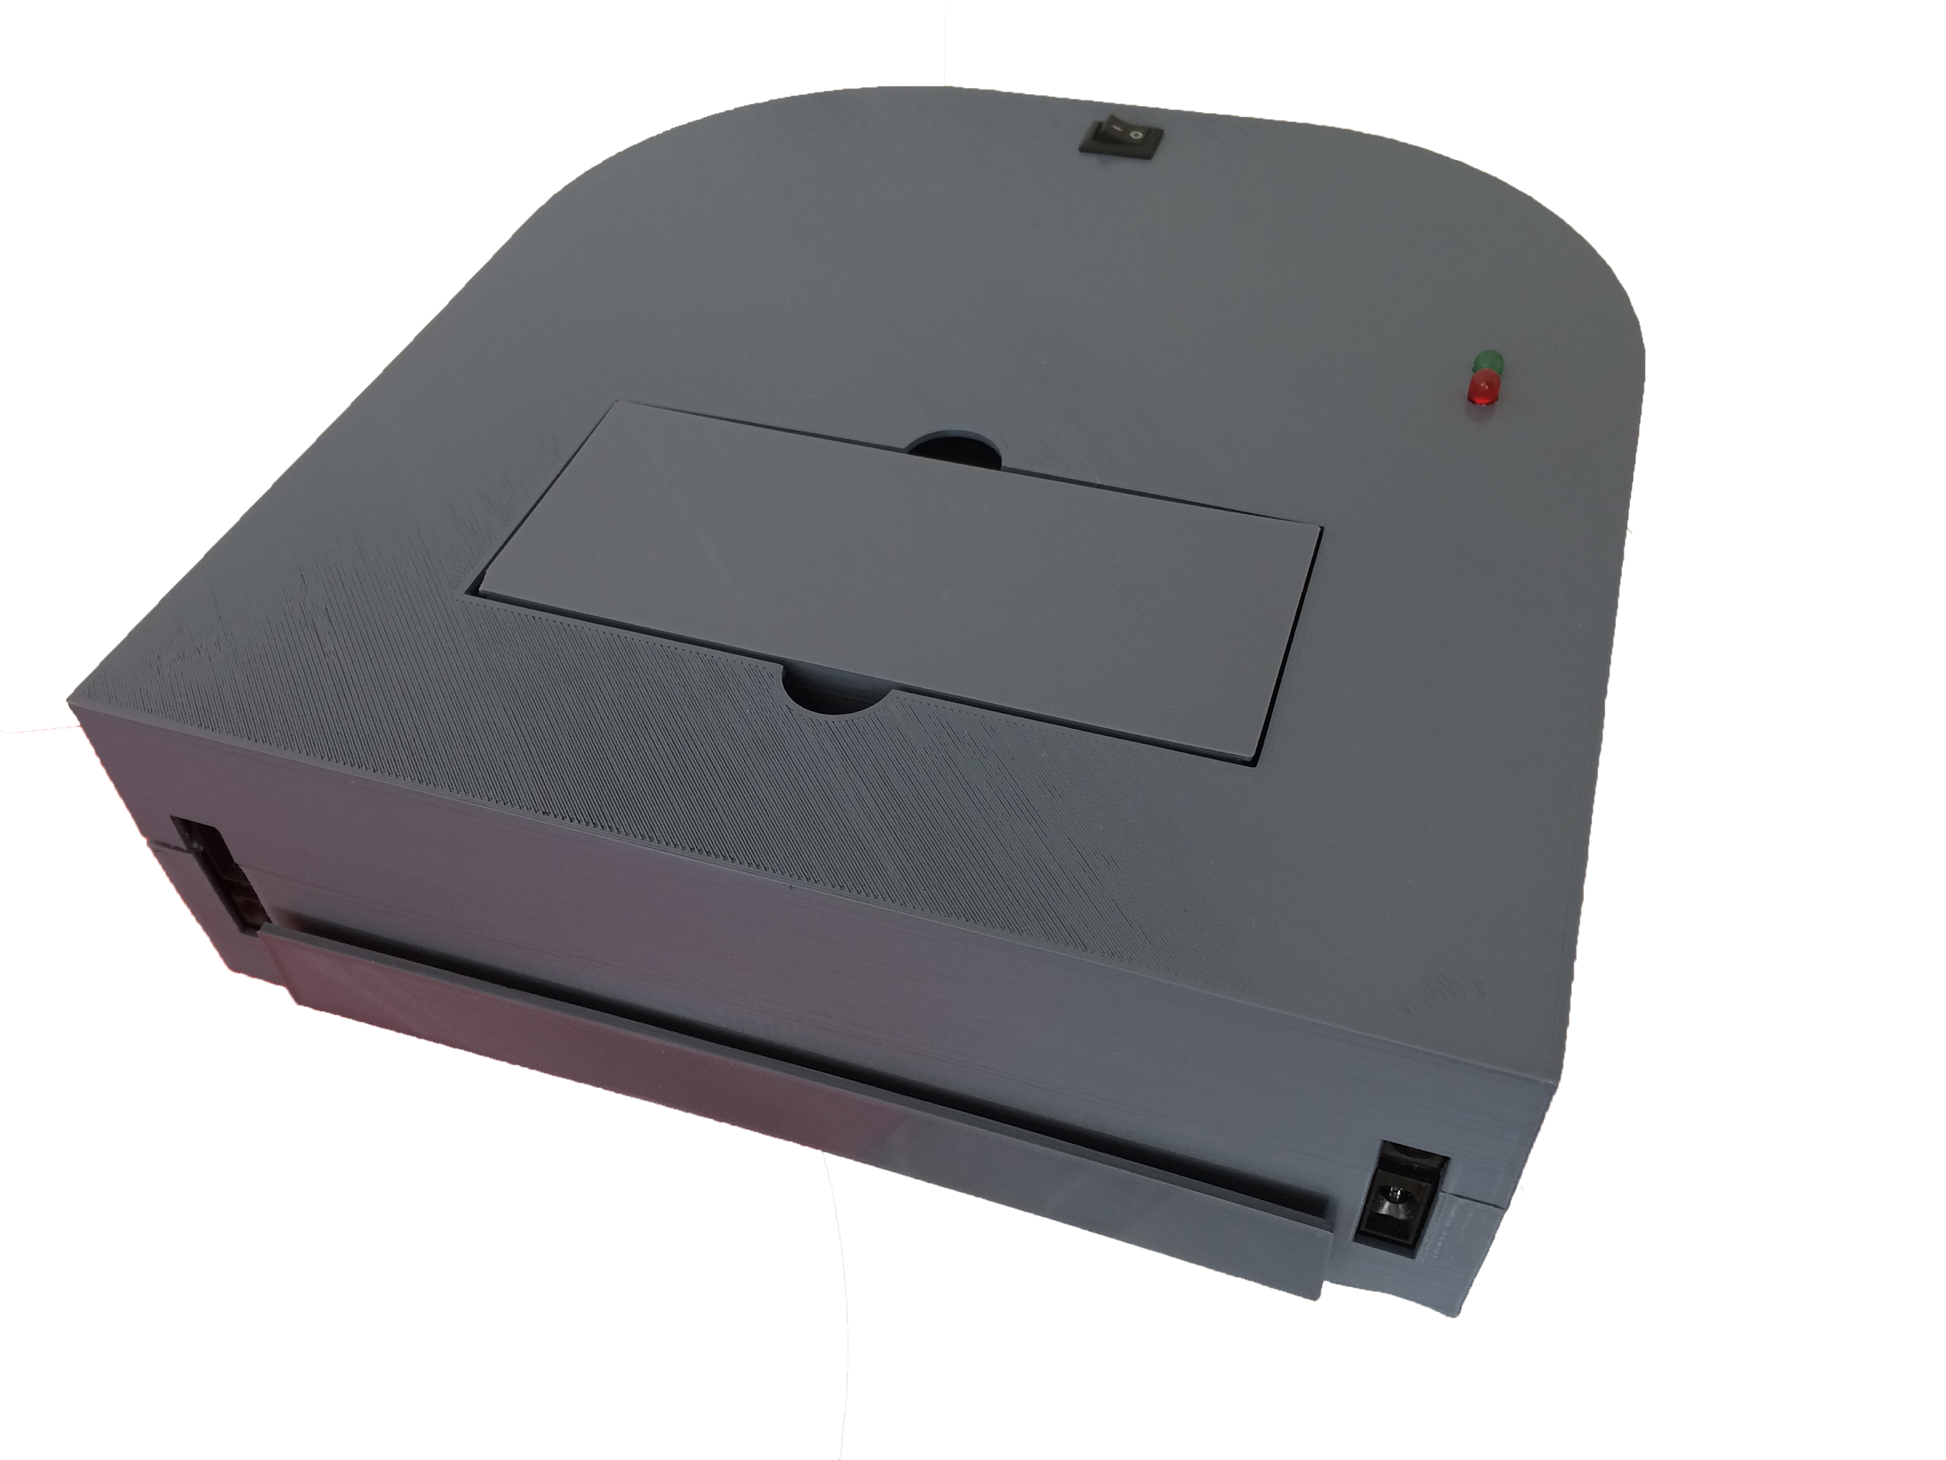
Most relevant snapshot of the project

Slide 10
Professional and technical learning
Professional Learning
Team work
Leadership
Communication
Technical Learning
Arduino Programming
Machine learning
Java (Android app)
Cloud Computing(Internet of things)

Slide 11
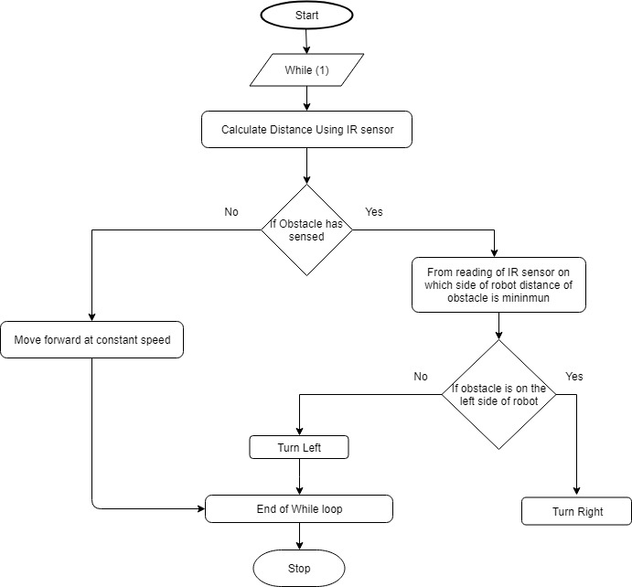
Flowchart

Slide 12
Key Highlights of the Project/Outcome
Autonomous with collision detection
Robotic Cleaning solution at cheaper cost
Small and intelligent
Controlled through Mobile App through internet
IOT enabled

